Slide 1
Chhs panther band PARENT meeting
Monday, April 25th 2016

Slide 2
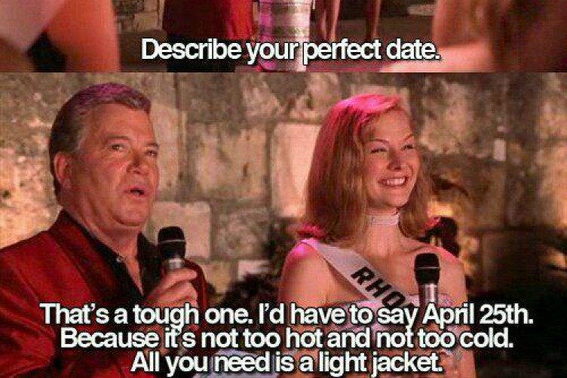
Welcome!

Slide 3
Returning Staff
All Band Directors! (First time in 5 years!)
Colorguard Caption Head
Martin Godoy
Visual Caption Head/Drill Designer
Jeremy Seneca
Assistant Percussion Director
Dan Darrah

Slide 4
CHHS Band 5-Year Plan
2016-2017: BOA Conroe and San Antonio
2017-2018: State Marching Contest and BOA San Antonio
2018-2019: BOA Grand Nationals in Indianapolis
2019-2020: State Marching Contest and BOA San Antonio
2020-2021: Disney World/Festival Disney

Slide 5
This Week
Marching Audition Workshops
4:15-6:15pm
Tuesday-Friday
Students should bring:
Athletic clothing
Water
We will practice indoors in case of rain (rehearsal will NOT be cancelled)

Slide 6
Registration and Auditions
Saturday, April 30th
Panther Den and Main Gym
Auditions will be scheduled by instrument
Commitment Form and First payment of $150 Due
Will be able to order uniform items and spirit wear for next season
Families will register after a student auditions

Slide 7
Marching Audition Schedule
9:00 Flute
9:45 Clarinet/Bass Clarinet
10:25 Saxophone
11:00 Trumpet
12:20 Horn
12:45 Trombone/Baritone
1:20 Tuba
1:40 Battery Percussion
2:05 Color Guard

Slide 8
Looking Ahead this Spring
Music Camp
Monday-Friday May 9th-13th
4:15-6:15
Parent Performance Friday May 13th
Marching Camps
Saturday, May 7th
Saturday, May 14th
Friday, May 20th
Tuesday, May 24th
Wednesday, May 25th
Parent Performance Wednesday, May 25th

Slide 9
Summer Band Camp
Begins Wednesday, July 27th
Required for course credit (P.E. Waiver)
Please schedule family vacations before this date
Uniform Fitting/Supply Pick-Up/Parent Meeting: Monday, July 25th
Picture Day: Tuesday, July 26th
Additional Dance Guard/Percussion Camps
See Calendar for details

Slide 10
Competition Schedule
BOA Conroe in Houston
Saturday, October 1st
BOA DFW - location TBA
Saturday, October 8th
UIL at Pennington Field
Tuesday, October 18th
BOA San Antonio Super Regional
Friday-Saturday, November 4-5th

Slide 11
BOA Competition Fee: $500
BOA Conroe
Charter Bus
Entry Fee
All Meals
BOA San Antonio Super Regional
Charter Bus
Entry Fee
All Meals
2-night stay
Sea World ticket/meal voucher

Slide 12
Band Fee: $850
The fee allows our band program to offer more opportunity than what the district budget provides
This includes the following:
Instructors and consultants
Marching band music and drill design
Additional equipment/uniform needs
Additional transportation
Financial Aid Application found on the website

Slide 13
Why the Increase?
Increasing Cost for services (inflation)
Better quality for your money
Better designed show:
Props, Equipment
Music Arrangement and Copyright
Music Caption/Staff positions added
Slightly less students in the program (school size is decreasing down to 5A)
General Fundraisers

Slide 14
Payment Schedule
$150 - April 30th (Registration)
$200 - June 21st
$200 - July 26th
$200 - August 23rd
$200 - September 27th
$200 - October 25th
$200 - November 29th
Total: $850 + $500
Sibling Discount
50% for the 2nd student
75% for the 3rd and beyond

Slide 15
Booster Mission
The Band Booster Club is a non-profit organization whose purpose is to help promote a better band, school and community spirit by volunteering our time and skills as well as provide financial support to full-fill the goals and objectives set forth by the Band Directors.
Without all these components our student experience is negatively impacted.

Slide 16
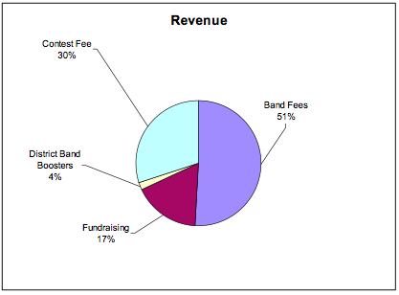
Booster Budget – Revenue

Slide 17
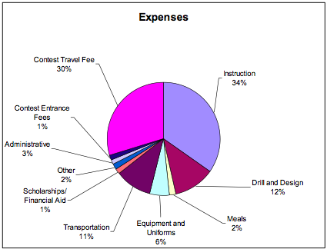
Booster Budget – Expenses

Slide 18
Corporate Sponsorship/Fundraising
What is Corporate Sponsorship?
Restaurant Nights
Future Fundraisers
A full plan will be available at the July 25th meeting

Slide 19
Volunteers
Your students experience in band is elevated by your support of the program.
Key positions waiting for you:
Assistant VP
Chaperone Lead
Volunteer Coordinator
Uniform Washing Lead
Uniform Fitting Lead
Banquet Coordinator
This coming Saturday during registration you will have the opportunity to select the volunteer positions that interest you. Please remember, our students need YOU!

Slide 20
2016 GCISD Bond
The bond package was assembled by the FIRST committee – the Facility Innovation & Readiness Stakeholder Team. This group was made up of 59 GCISD parents, community members and district employees, with representatives from every campus, who worked for 8 months to develop the project list
The proposed projects will impact every campus in the district in some way. General projects focus on the areas of:
Security (adding cameras, security entrances, and security system)

Slide 21
2016 GCISD Bond
Growth/Evolution (new schools, new additions to accommodate the STEM program and 2 new multipurpose activity centers)
Infrastructure (improvements to HVAC, accessibility, school buses, computers and playground equipment)
Classroom Experience (new furniture, computers/technology, high school performance areas and collaborative spaces
Early voting is going on now.
Election Day is Saturday, May 3rd.

